Slide 1
Magruder’s American Government
C H A P T E R 13 The Presidency

Slide 2
S E C T I O N 1 The President’s Job Description
What are the President’s many roles?
What are the formal qualifications necessary to become President?
What issues have arisen involving the length of the President’s term?
How is the President compensated?

Slide 3
The President’s Roles
Chief of State
The President is chief of state. This means he is the ceremonial head of the government of the United States, the symbol of all the people of the nation.
Chief Executive
The Constitution vests the President with the executive power of the United States, making him or her the nation’s chief executive.
Chief Administrator
The President is the chief administrator, or director, of the United States government.
Chief Diplomat
As the nation’s chief diplomat, the President is the main architect of American foreign policy and chief spokesperson to the rest of the world.

Slide 4
More Roles of the President
Commander in Chief
The Constitution makes the President the commander in chief, giving him or her complete control of the nation’s armed forces.
Chief Legislator
The President is the chief legislator, the main architect of the nation’s public policies.
Chief of Party
The President acts as the chief of party, the acknowledged leader of the political party that controls the executive branch.
Chief Citizen
The President is expected to be “the representative of all the people.”

Slide 5
Qualifications for President
Article II, Section 1, Clause 5, of the Constitution says that the President must:

Slide 6
The President’s Term
Until 1951, the Constitution placed no limit on the number of terms a President might serve.
Traditionally, Presidents limited the number of terms served to two. This tradition was broken by Franklin D. Roosevelt in 1940 when he ran for and won a third term in office. He then went on to be elected to a fourth term in 1944.
The 22nd Amendment placed limits on presidential terms. A President now may not be elected more than twice or only once if they became President due to succession.

Slide 7

Pay and Benefits
Congress determines the President’s salary, and this salary cannot be changed during a presidential term.
The President’s pay was first set at $25,000 a year. Currently, the President is paid $400,000 a year.
Congress has also approved an expense allowance for the President, which is currently $50,000 a year.
Besides monetary benefits, the President gets to live in the 132-room mansion that we call the White House.
The President is also granted other benefits, including a large suite of offices, a staff, the use of Air Force One, and many other fringe benefits.
2
3
4
5
Chapter 13, Section 1

Slide 8
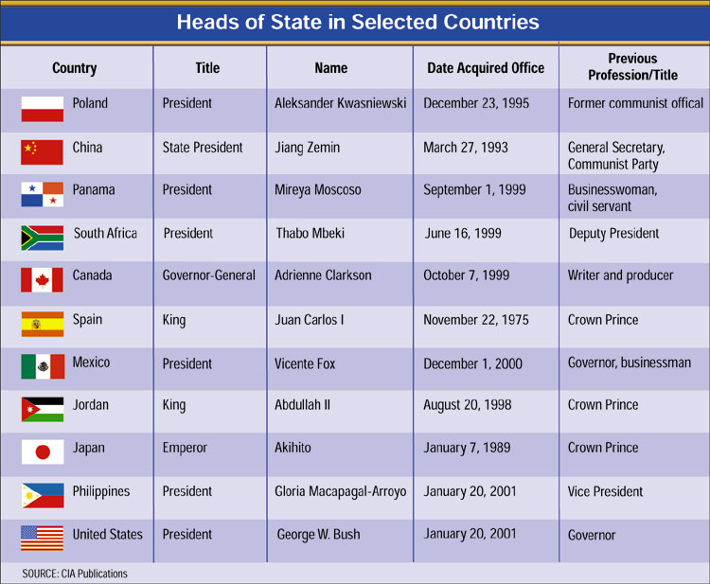
Comparative Governments: Other Heads of State
2
3
4
5
Chapter 13, Section 1

Slide 9
Section 1 Review
1. As commander in chief, the President
(a) is the leader of all the nation’s armed forces.
(b) initiates legislation.
(c) is the director of the government.
(d) represents the citizens of the United States abroad.
2. In order to become President, a citizen needs to be at least
(a) 25 years old.
(b) 35 years old.
(c) 45 years old.
(d) 30 years old.
Want to connect to the Magruder’s link for this section? Click Here!
2
3
4
5
Chapter 13, Section 1

Slide 10
S E C T I O N 2 Presidential Succession and the Vice Presidency
How does the Constitution provide for presidential succession?
What are the constitutional provisions for presidential disability?
What is the role of the Vice President?
1
3
4
5
Chapter 13, Section 2

Slide 11
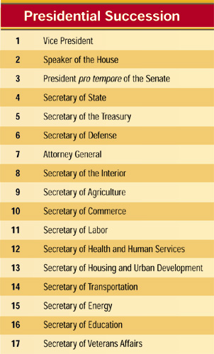
The Constitution and Succession
Presidential succession is the plan by which a presidential vacancy is filled.
The 25th Amendment, ratified in 1967, made it clear that the Vice President will become President if the President is removed from office.
The Presidential Succession Act of 1947 set the order of succession following the Vice President.
1
3
4
5
Chapter 13, Section 2

Slide 12
Presidential Disability
Sections 3 and 4 of the 25th Amendment provide procedures to follow when the President is disabled.
The Vice President is to become acting President if
(1) the President informs Congress, in writing, “that he is unable to discharge the powers and duties of his office,” or
(2) the Vice President and a majority of the members of the Cabinet inform Congress, in writing, that the President is thus incapacitated.
1
3
4
5
Chapter 13, Section 2

Slide 13
The Vice Presidency
The Constitution only gives the Vice President two duties besides becoming President if the President is removed from office:
1) to preside over the Senate, and
2) to help decide the question of presidential disability.
If the office of Vice President becomes vacant, the President nominates a new Vice President subject to the approval of Congress.
Today, the Vice President often performs diplomatic and political chores for the President.
1
3
4
5
Chapter 13, Section 2

Slide 14
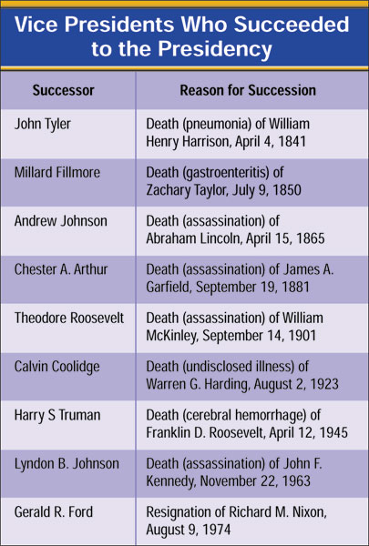
Into the Oval Office
1
3
4
5
Chapter 13, Section 2

Slide 15
Section 2 Review
1. Who is in line for presidential succession following the Vice President?
(a) the First Lady
(b) the Speaker of the House
(c) the president of the Senate
(d) the Secretary of State
2. Which constitutional amendment provides for presidential succession?
(a) the 25th Amendment
(b) the 26th Amendment
(c) the 22nd Amendment
(d) the 21st Amendment
Want to connect to the Magruder’s link for this section? Click Here!
1
3
4
5
Chapter 13, Section 2

Slide 16
S E C T I O N 3 Presidential Selection: The Framers’ Plan
What were the Framers’ original provisions for choosing the President?
How did the rise of political parties change the original provisions set out in the Constitution?
1
2
4
5
Chapter 13, Section 3

Slide 17
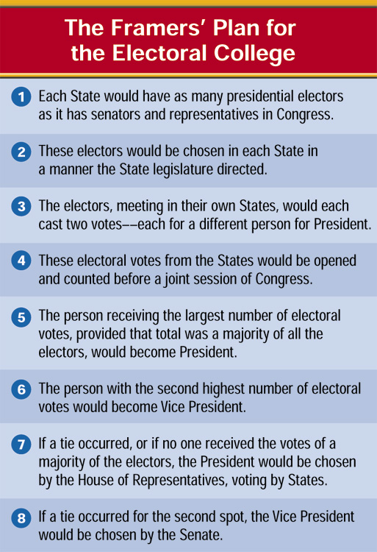
Original Provisions
According to the Constitution, the President and Vice President are chosen by a special body of presidential electors.
Originally, these electors each cast two electoral votes, each for a different candidate. The candidate with the most votes would become President, and the candidate with the second highest total would become Vice President.
1
2
4
5
Chapter 13, Section 3

Slide 18
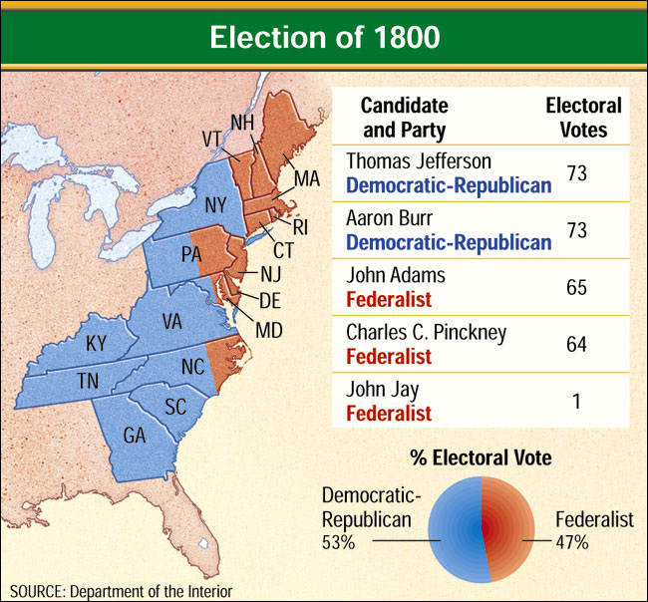
The Rise of Parties
The electoral college is the group of people (electors) chosen from each State and the District of Columbia that formally selects the President and Vice President. With the rise of political parties in 1796, flaws began to be seen in the system.
1
2
4
5
Chapter 13, Section 3

Slide 19
The 12th Amendment
The 12th Amendment was added to the Constitution in 1804 following the election of 1800.
The major change in the electoral college made by the amendment was that each elector would distinctly cast one electoral vote for President and one for Vice President.
1
2
4
5
Chapter 13, Section 3

Slide 20
Section 3 Review
1. Which year’s election paved the way for changes in the electoral college?
(a) 1800
(b) 1792
(c) 1804
(d) 1812
2. Which amendment to the Constitution modified the electoral college to avoid electoral ties for the office of President?
(a) the 11th Amendment
(b) the 5th Amendment
(c) the 9th Amendment
(d) the 12th Amendment
Want to connect to the Magruder’s link for this section? Click Here!
1
2
4
5
Chapter 13, Section 3

Slide 21
S E C T I O N 4 Presidential Nominations
What role do conventions play in the presidential nominating process?
How important are presidential primaries?
What differences exist between the caucus-convention process and the primary process?
What events take place during a national convention?
What characteristics determine who is nominated as a presidential candidate?
1
2
3
5
Chapter 13, Section 4

Slide 22
The Role of Conventions
Convention Arrangements
The convention system has been mainly built by the two major parties in American politics.
Party national committees arrange the time and place for their party’s nominating convention.
The Apportionment and Selection of Delegates
Parties apportion the number of delegates each State will receive based on electoral votes and other factors.
Delegates are selected through both presidential primaries and the caucus-convention process.
1
2
3
5
Chapter 13, Section 4

Slide 23
Presidential Primaries
Depending on the State, a presidential primary is an election in which a party’s voters
(1) choose some or all of a State’s party organization’s delegates to their party’s national convention, and/or
(2) express a preference among various contenders for their party’s presidential nomination.
Many States use a proportional representation rule to select delegates. In this system, a proportion of a State’s delegates are chosen to match voter preferences in the primary.
More than half of the States hold preference primaries where voters choose their preference for a candidate. Delegates are selected later to match voter preferences.
1
2
3
5
Chapter 13, Section 4

Slide 24
The Caucus-Convention Process
In those States that do not hold presidential primaries, delegates to the national conventions are chosen in a system of caucuses and conventions.
The party’s voters meet in local caucuses where they choose delegates to a local or district convention, where delegates to the State convention are picked.
At the State level, and sometimes in the district conventions, delegates to the national convention are chosen.
1
2
3
5
Chapter 13, Section 4

Slide 25
The National Convention
A party’s national convention is the meeting at which delegates vote to pick their presidential and vice-presidential candidates. Party conventions accomplish three main goals:
(1) to officially name the party’s presidential and vice-presidential candidates,
(2) to bring the various factions and the leading personalities in the party together in one place for a common purpose, and
(3) to adopt the party’s platform—its formal statement of basic principles, stands on major policy matters, and objectives for the campaign and beyond.
1
2
3
5
Chapter 13, Section 4

Slide 26
Who Is Nominated?
If an incumbent President wants to seek reelection, his or her nomination is almost guaranteed.
Political experience factors into the nomination process. State governors, the executive officers on the State level, have historically been favored for nomination. U.S. senators also have fared well.
Many candidates come from key larger states. Candidates from larger states, such as California, New York, and Ohio, have usually been seen as more electable than candidates from smaller states.
1
2
3
5
Chapter 13, Section 4

Slide 27
Section 4 Review
1. More than half of the presidential primary States hold only a
(a) caucus.
(b) winner-take-all primary.
(c) preference primary.
(d) nominating convention.
2. A party’s formal statement of its basic principles and views is called the party’s
(a) plank.
(b) primary.
(c) constitution.
(d) platform.
Want to connect to the Magruder’s link for this section? Click Here!
1
2
3
5
Chapter 13, Section 4

Slide 28
S E C T I O N 5 The Election
What is the function of the electoral college today?
What are the flaws in the electoral college?
What are the advantages and disadvantages of proposed reforms in the electoral college?
1
2
3
4
Chapter 13, Section 5

Slide 29
The Electoral College Today
Voters do not vote directly for the President. Instead, they vote for electors in the electoral college.
All States, except two (Maine and Nebraska), select electors based on the winner of the popular vote in that State.
Electors then meet in the State capitals on the Monday after the second Wednesday in December and cast their votes for President and Vice President.
On January 6, the electoral votes cast are counted by the president of the Senate, and the President and Vice President are formally elected.
If no candidate wins a majority of electoral votes (270), the election is thrown into the House of Representatives.
1
2
3
4
Chapter 13, Section 5

Slide 30
Flaws in the Electoral College
There are three major defects in the electoral college:
(1) It is possible to win the popular vote in the presidential election, but lose the electoral college vote. This has happened four times in U.S. history (1824, 1876, 1888, and 2000).
(2) Nothing in the Constitution, nor in any federal statute, requires the electors to vote for the candidate favored by the popular vote in their State.
(3) If no candidate gains a majority in the electoral college, the election is thrown into the House, a situation that has happened twice (1800 and 1824). In this process, each State is given one vote, meaning that States with smaller populations wield the same power as those with larger populations.
1
2
3
4
Chapter 13, Section 5

Slide 31
Proposed Reforms
In the district plan, electors would be chosen the same way members of Congress are selected: each congressional district would select one elector (just as they select representatives), and two electors would be selected based on the overall popular vote in a State (just as senators are selected).
A commonly heard reform suggests that the electoral college be done away with altogether in favor of direct popular election. At the polls, voters would vote directly for the President and Vice President instead of electors.
The proportional plan suggests that each candidate would receive the same share of a State’s electoral vote as he or she received in the State’s popular vote.
The national bonus plan would automatically offer the winner of the popular vote 102 electoral votes in addition to the other electoral votes he or she might gain.
1
2
3
4
Chapter 13, Section 5

Slide 32
Electoral College Supporters
There are two major strengths of the electoral college that its supporters espouse:
It is a known process. Each of the proposed, but untried, reforms may very well have defects that could not be known until they appeared in practice.
In most election years, the electoral college defines the winner of the presidential election quickly and certainly.
1
2
3
4
Chapter 13, Section 5

Slide 33
Section 5 Review
1. Which of the following is a possible flaw of the electoral college system?
(a) Electors are not bound to cast their electoral vote for the party they represent.
(b) A candidate can fail to win a majority of electoral votes
(c) A candidate can win the popular vote but lose the electoral vote.
(d) All of the above.
2. The proportional plan for electoral college reform suggests that
(a) electors are chosen by State legislatures.
(b) candidates receive a share of a State’s electoral votes correlating to his or her share of the State’s popular vote.
(c) electors are chosen based on congressional districts.
(d) the candidate that wins the popular vote automatically receives 102 electoral votes.
Want to connect to the Magruder’s link for this section? Click Here!
1
2
3
4
Chapter 13, Section 5

