Slide 1
American Government
Origins of American Government

Slide 2
C H A P T E R 2 Origins of American Government
SECTION 1 Our Political Beginnings
SECTION 2 The Coming of Independence
SECTION 3 The Critical Period
SECTION 4 Creating the Constitution
SECTION 5 Ratifying the Constitution

Slide 3
S E C T I O N 1 Our Political Beginnings
What basic concepts of government were held by American colonists?
Which important English documents have had the most influence on our government?
How were the governments of the thirteen colonies organized?

Slide 4
Basic Concepts of Government
The English colonists in America brought with them three main concepts:
The need for an ordered social system, or government.
The idea of limited government, that is, that government should not be all-powerful.
The concept of representative government—a government that serves the will of the people.

Slide 5
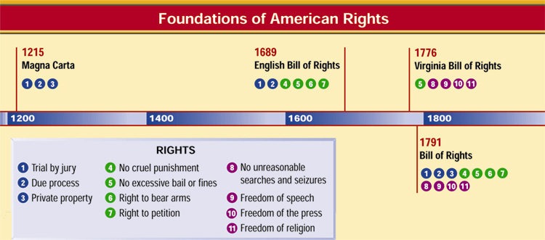
Important English Documents
The way our government works today can be traced to important documents in history:

Slide 6
The Thirteen Colonies
There were three types of colonies in North America: royal, proprietary, and charter.
The royal colonies were ruled directly by the English monarchy.
The King granted land to people in North America, who then formed proprietary colonies.
The charter colonies were mostly self-governed, and their charters were granted to the colonists.

Slide 7
Section 1 Review
1. All of the following are basic concepts of government brought to the colonies by English settlers EXCEPT
(a) the need for limited government.
(b) the need for a representative government.
(c) the need for an autocratic government.
(d) the need for an ordered social system.
2. Which of the following was not one of the rights granted in the Magna Carta?
(a) The right to private property.
(b) The right to a trial by jury.
(c) The right to freedom of religion.
(d) The right to undergo due process of the law.

Slide 8
S E C T I O N 2 The Coming of Independence
What were Britain’s colonial policies and how did the colonists react to them?
What were the outcomes of the First and Second Continental Congresses?
How did American independence come about, and what were its effects?

Slide 9
British Colonial Policies
Until the mid-1700s, the colonies were allowed a great deal of freedom in their governments by the English monarchy.
In 1760, King George III imposed new taxes and laws on the colonists.
The colonists started a confederation, proposed an annual congress, and began to rebel.

Slide 10
Growing Colonial Unity
Early Attempts
In 1643, several New England settlements formed the New England Confederation.
A confederation is a joining of several groups for a common purpose.
The Albany Plan
In 1754, Benjamin Franklin proposed the Albany Plan of Union, in which an annual congress of delegates (representatives) from each of the 13 colonies would be formed.
The Stamp Act Congress
In 1765, a group of colonies sent delegates to the Stamp Act Congress in New York.
These delegates prepared the Declaration of Rights and Grievances against British policies and sent it to the king.

Slide 11
The Continental Congresses
First Continental Congress
The colonists sent a Declaration of Rights to King George III.
The delegates urged each of the colonies to refuse all trade with England until British tax and trade regulations were repealed, or recalled.
Second Continental Congress
In 1775, each of the 13 colonies sent representatives to this gathering in Philadelphia.
The Second Continental Congress served as the first government of the United States from 1776 to 1781.

Slide 12
American Independence
On July 4, 1776, the Second Continental Congress adopted the Declaration of Independence.
Between 1776 and 1777, most of the States adopted constitutions instead of charters.

Slide 13

Common Features of State Constitutions
Common Features of State Constitutions
The principle of popular sovereignty was the basis for every new State constitution. That principle says that government can exist and function only with the consent of the governed. The people hold power and the people are sovereign.
Popular Sovereignty
The concept of limited government was a major feature of each State constitution. The powers delegated to government were granted reluctantly and hedged with many restrictions.
Limited Government
In every State it was made clear that the sovereign people held certain rights that the government must respect at all times. Seven of the new constitutions contained a bill of rights, setting out the “unalienable rights” held by the people.
Civil Rights and Liberties
The powers granted to the new State governments were purposely divided among three branches: executive, legislative, and judicial. Each branch was given powers with which to check (restrain the actions of) the other branches of the government.
Separation of Powers and Checks and Balances

Slide 14
Section 2 Review
1. The Declaration of Independence was signed in
(a) 1765.
(b) 1776.
(c) 1781.
(d) 1787.
2. The Stamp Act of 1765 was a law enacted by the British that
(a) increased the colonists’ taxes.
(b) was repealed by the Magna Carta.
(c) the colonists ratified one year later.
(d) raised the price of postage stamps by two cents.

Slide 15
S E C T I O N 3 The Critical Period
What were the Articles of Confederation?
Why were the 1780s a critical period in United States history?
What did America do to create a stronger government in the 1780s?

Slide 16
The Articles of Confederation
The Articles of Confederation established “a firm league of friendship” among the States.
Powers
Congress was given the power to declare war, deal with national finance issues, and settle disputes among the States.
Obligations
The States promised to obey Congress, and to respect the laws of the other States. Most other powers were retained by each State.

Slide 17
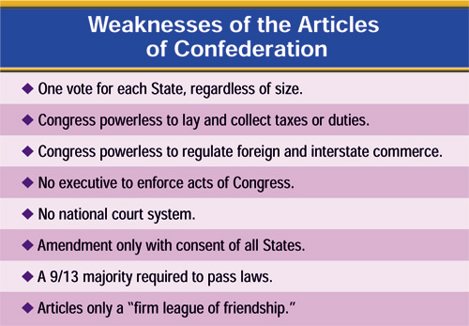
Weaknesses of the Articles of Confederation

Slide 18
A Call for a Stronger Government
Representatives from Maryland and Virginia met at Mount Vernon, Virginia, in 1785 to discuss trade issues.
The meeting was so successful that the Virginia General Assembly requested a meeting of all thirteen States, which eventually became the Constitutional Convention in Philadelphia.

Slide 19
Section 3 Review
1. The government set up by the Articles of Confederation had
(a) the power to make treaties and build a navy.
(b) a bicameral congress.
(c) separation of powers.
(d) a President to carry out its laws.
2. Which of the following was a weakness of the Articles of Confederation?
(a) Congress could not make treaties.
(b) Congress could not borrow money.
(c) The States did not agree to obey the Articles.
(d) Congress could not lay or collect taxes or duties.

Slide 20
S E C T I O N 4 Creating the Constitution
Who were the Framers of the Constitution?
What were the differences between the Virginia Plan and the New Jersey Plan?
What were some of the compromises on which the Constitutional Convention agreed?
What sources did the delegates draw on and how did they react when they completed the Constitution?

Slide 21
Framers of the Constitution

Slide 22
Different Constitutional Plans
The Virginia Plan
Three branches of government
Bicameral legislature
“National Executive” and “National Judiciary”
The New Jersey Plan
Unicameral Congress
Equal representation for States of different sizes
More than one federal executive

Slide 23
Constitutional Compromises
The Connecticut Compromise
Delegates agreed on a bicameral Congress, one segment with equal representation for States, and the other with representation proportionate to the States’ populations.
The Three-Fifths Compromise
The Framers decided to count a slave as three-fifths of a person when determining the population of a State.
The Commerce and Slave Trade Compromise
Congress was forbidden from taxing exported goods, and was not allowed to act on the slave trade for 20 years.

Slide 24
Influences on and Reactions to the New Constitution
Influences
The Framers were familiar with the political writings of their time, such as works by Jean Jacques Rousseau and John Locke.
They also were seasoned, variously, by the Second Continental Congress, the Articles of Confederation and experiences with their own State governments.
Reactions
When the Constitution was complete, the Framers’ opinions of their work varied. Some were disappointed, like George Mason of Virginia, who opposed the Constitution until his death in 1792.
Most agreed with Ben Franklin’s thoughts when he said,
“From such an assembly [of fallible men] can a perfect production be expected? It…astonishes me, Sir, to find this system approaching so near to perfection as it does…”

Slide 25
Section 4 Review
1. The first national government for the United States was
(a) the First Continental Congress.
(b) the Second Continental Congress.
(c) the Articles of Confederation.
(d) the Constitution of the United States.
2. The Constitutional Convention in Philadelphia involved delegates from each of the following states except
(a) Maryland.
(b) Rhode Island.
(c) New York.
(d) Virginia.

Slide 26
S E C T I O N 5 Ratifying the Constitution
Who were the Federalists and the Anti-Federalists?
How long did the ratification of the Constitution take?
What happened after its ratification?

Slide 27
The Federalists and Anti-Federalists
The Constitution was very controversial at first, with some groups supporting it, and others attacking it.
Federalists thought that the Articles of Confederation were weak, and argued for the ratification of the Constitution.
Anti-Federalists objected to the Constitution for many reasons, including the strong central government and the lack of a bill of rights.

Slide 28
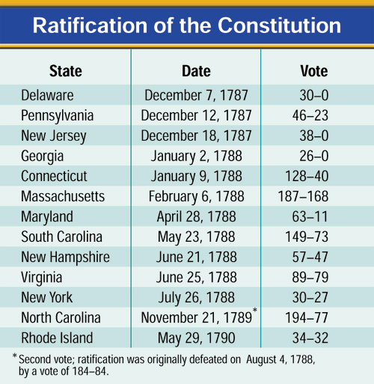
The Constitution is Ratified
Nine States ratified the Constitution by June 21, 1788, but the new government needed the ratification of the large States of New York and Virginia.
Great debates were held in both States, with Virginia ratifying the Constitution June 25, 1788.
New York’s ratification was hard fought. Supporters of the Constitution published a series of essays known as The Federalist.

Slide 29
Inaugurating the Government
The new Congress met for the first time on March 4, 1789.
Congress finally attained a quorum (majority) on April 6 and counted the electoral votes. Congress found that George Washington had been unanimously elected President. He was inaugurated on April 30.

Slide 30
Section 5 Review
1. The debate over the ratification of the Constitution was won by the
(a) Anti-Federalists.
(b) Whigs.
(c) Federalists.
(d) Tories.
2. The temporary capital of the United States where Congress met in 1789 was
(a) Washington, D.C.
(b) Philadelphia.
(c) New York.
(d) Mount Vernon.

